Slide 1



NutriBox
NutriBox
2025
Prepared By
NutriBox Team

Slide 2

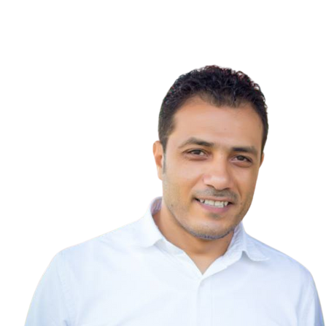
Under Supervision of
Dr. Tamer El Moghazy
Technical Instructor

Slide 3
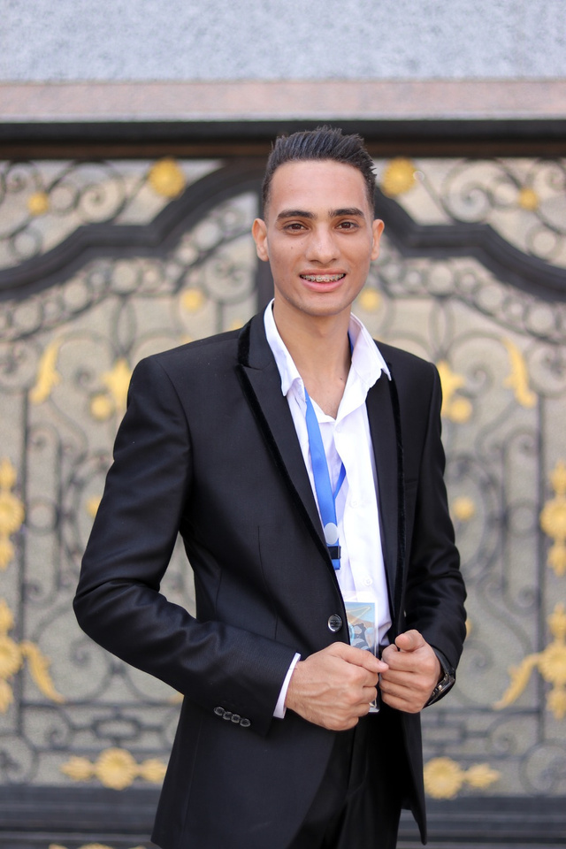
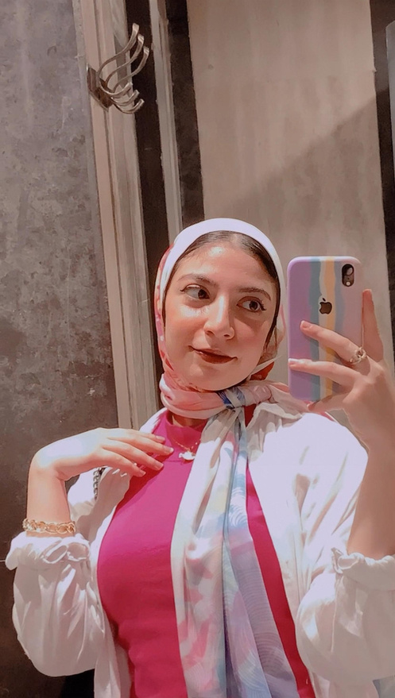
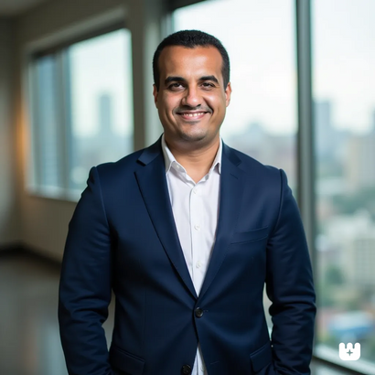

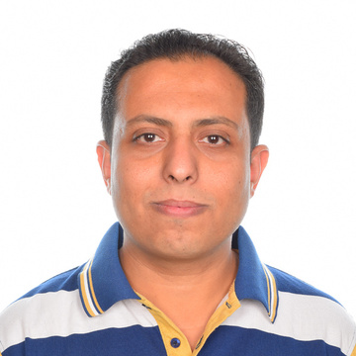
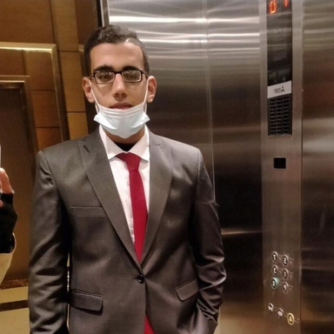
Our Project Team
Gergs Magdy
Merehan Asal
Ahmed Hosam
Anton Wadie
Almoatasembellah Magdy
Mostafa mohamed

Slide 4
Welcome
to Our NutriBox Presentation
Our initiative is dedicated to raising awareness about the importance of healthy eating and balanced lifestyles. We believe that good nutrition is the key to overall well-being, and our goal is to provide valuable insights that help young people make better food choices with ease.
Get ready to explore new ideas and practical solutions that make healthy eating an enjoyable part of your daily life!

Slide 5
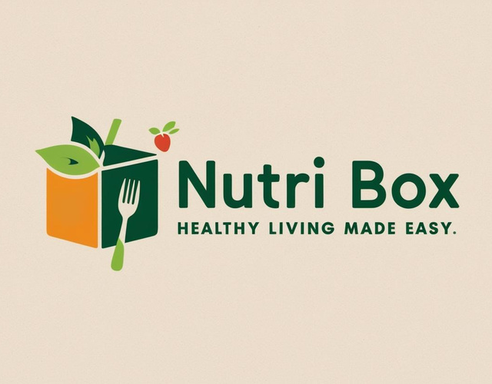
About Our Project
Nutribox
صحتك في بوكس غذائي صحي ! وطعم يفتح النفس
متخيل إنك تاكل أكل صحي،وطعمه حكايةبمذاق مصري أصيل
ومن غير ما توجع دماغك في التحضير؟
NutriBox
جمعنالك بين في الطعم اللذيذ والأكل المفيد،بمكونات طبيعية %100، عشان تستمتع بوجبة متكاملة منغير تأنيب
!ضمير

Slide 6
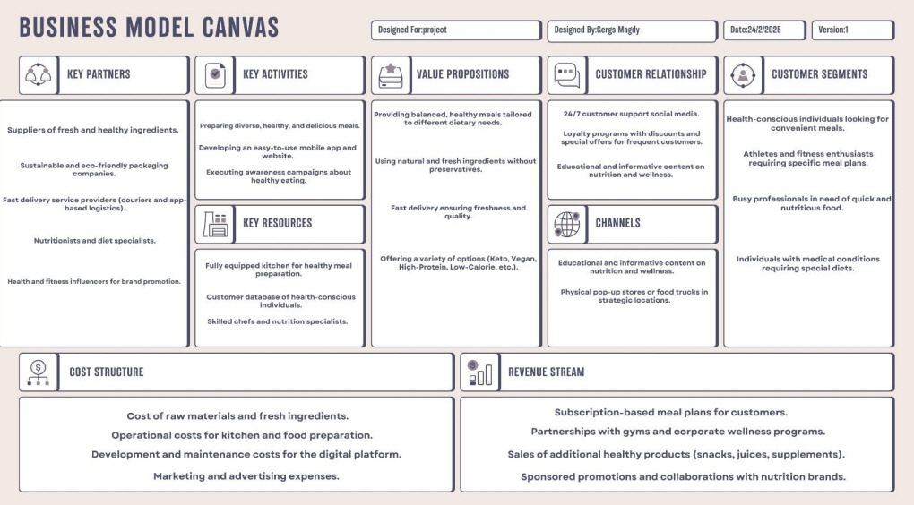

Slide 7






SWOT Analysis
Strengths
Weaknesses
Convenience & Flexibility:
Multiple ordering options
delivery, subscription, or pickup) to suit various customer needs.
Ready-to-eat meals save time for busy professionals and health-conscious individuals.
Fusion of traditional flavors with a modern, health-focused twist to appeal to diverse consumer preferences.
Limited Marketing Budget:
Logistics & Supply Chain Challenges:
Managing timely deliveries, quality control, and customer service can be complex.
High Price of our products
Threats
Opportunities
Rising Demand for Healthy Eating:
Growing awareness of balanced diets, fitness trends, and clean eating fuels the demand for NutriBox’s offerings.
Geographical Expansion:
Scale operations to new cities and regions across Egypt and beyond.
Economic & Market Fluctuations:
Inflation, economic instability, or rising costs of ingredients could impact affordability and profit margins.
Competition from Large Food Chains & Brands:
International food delivery services and large-scale healthy meal providers pose direct competition.

Slide 8

SMART Marketing and Financial Objectives
1.Branding and Visual Identity
Establish Visual Brand Identity
Launch a complete visual identity (logo, colors, guidelines) by Feb 14, 2025.
2. Social Media Page Creation and Follower Growth
Build Social Media Presence
Create Facebook, Instagram, and TikTok pages by Feb 22, 2025, and get 100 new followers per month. by 25 march we reached 150 followers on Facebook.
3. Increase Brand Awareness on Social Media by posting 4-5 times weekly from 26 Feb until 31 march, 2025, and achieve:
2% engagement rate of total user base.
5 engagements per post
15% monthly growth rate in overall user engagement.
4. Execute Ramadan-Specific Marketing Objective (Create and deploy Ramadan-specific content from march 1 - 31, 2025) and achieve:
At least 15 shares across all Ramadan content on all platforms
Ramadan content engagement 5% of total user base.
Reach at least 500 users across all Ramadan content on all platforms
5.Launch High-Impact, Cost-Efficient Paid Ads from March 29 to April 1, and achieve:
350+ engagements with an average cost per engagement at or below 3 EGP (the result was 0.5 egp per engagement), increase reach, and build stronger audience connections.
6.Communicate Value and build trust to Justify Pricing by posting 4 value-focused posts by March 31, 2025 , and achieve:
20+ engagements across all content

Slide 9
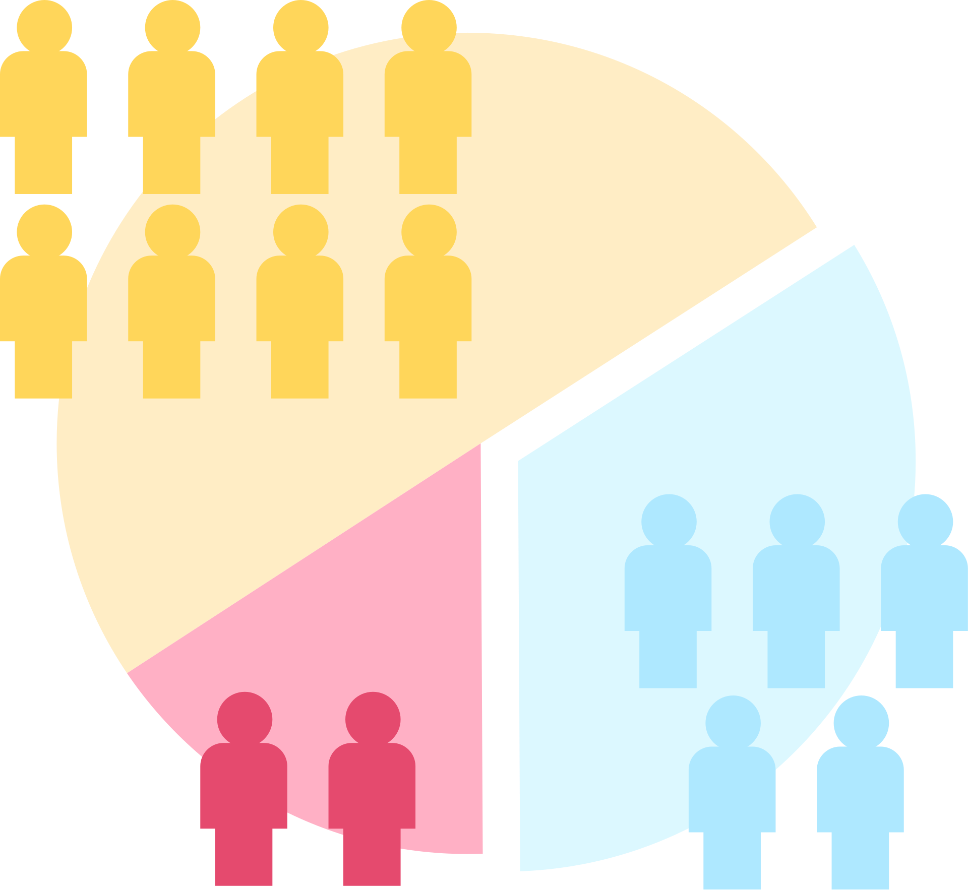
Market Segmentation
Since NutriBox is a B2C business operating in Cairo, we will segment the market based on the following criteria:
1. Geographic Segmentation
Location: Cairo and new cairo , zayed city , nasr city
2. Demographic Segmentation
Age: 20-50 years old
Gender: Male & Female
Income: Mid to High
3. Psychographic Segmentation
Personality:
Fitness Enthusiasts: Health-conscious, goal-driven
Busy Professionals: Efficiency-focused, prefer convenience
Busy Moms: Family-oriented, prioritize nutrition
Young Working Moms: Cautious, trust reliability
Attitudes & Lifestyle:
Strong belief in wellness, organic, and clean eating
Active in fitness, meal prepping, and social media health trends
Prefer digital ordering & easy meal solutions
Social Status:
Middle to upper-class professionals & families
4. Behavioral Segmentation
Benefits Sought:
High-protein, weight management, convenience, balanced nutrition
Purchasing Habits:
Regular buyers, discount seekers, trust-driven first-time buyers

Slide 10




The Target Market
Primary Target Market:
Fitness Enthusiasts & Busy Professionals (age 25-40)
Health-conscious individuals looking for high-protein meals, weight management options, and convenience.
Prefer digital purchasing via Instagram, WhatsApp, or a website.
Secondary Target Market:
Busy Moms & Young Working Moms (age 30-50)
Seeking healthy and nutritious meals for their families or themselves.
Prefer easy ordering, reliable delivery, and trusted brands.

Slide 11
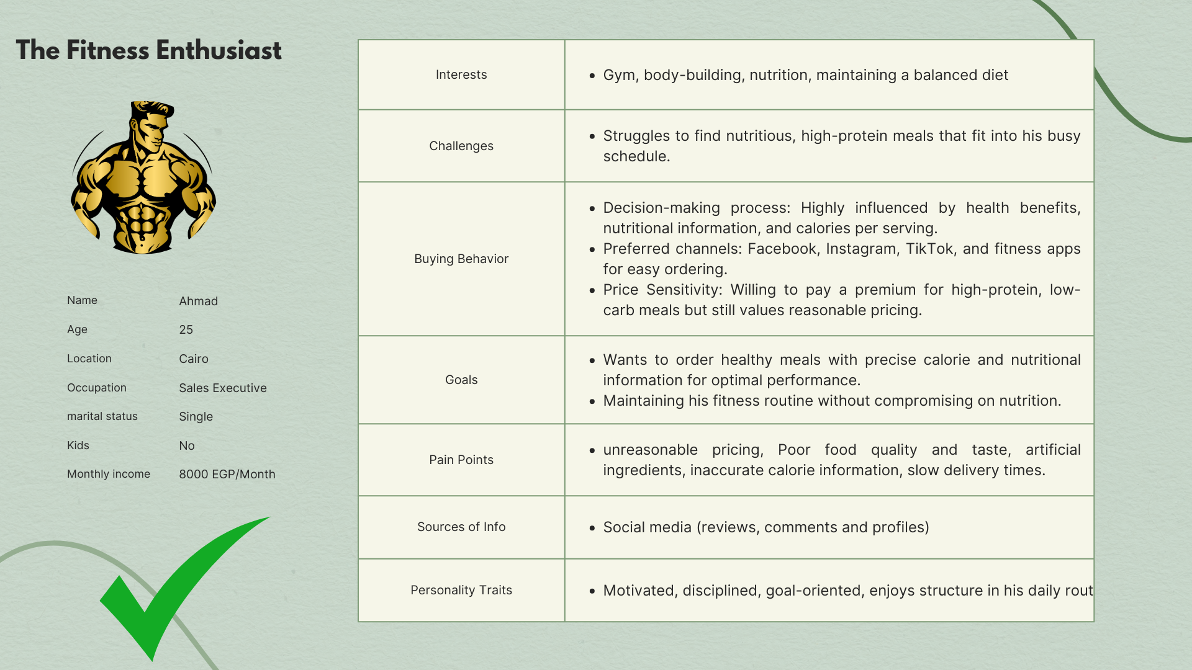

Slide 12
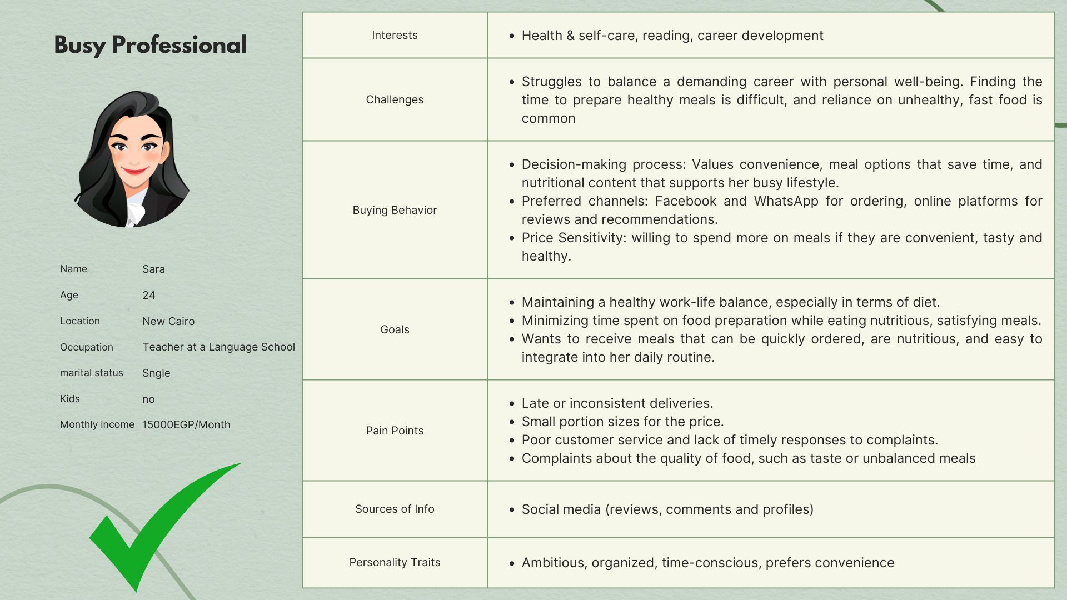

Slide 13
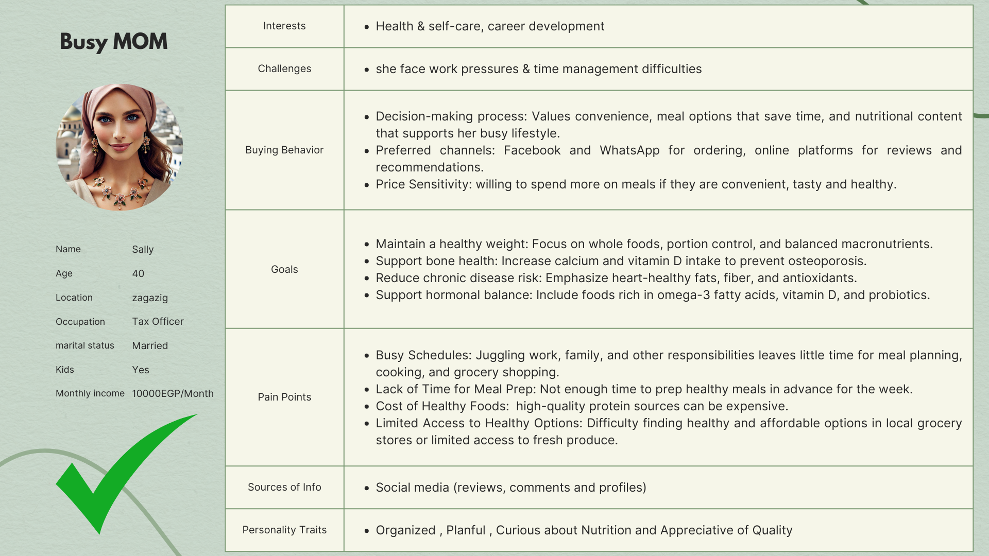

Slide 14
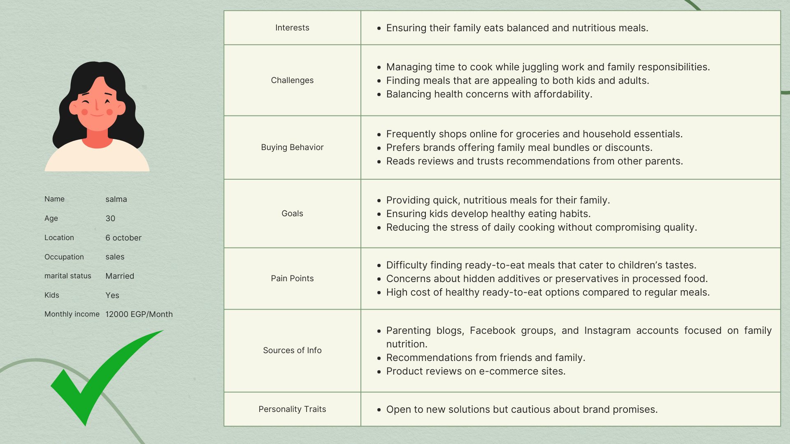
Young Working Mom

Slide 15
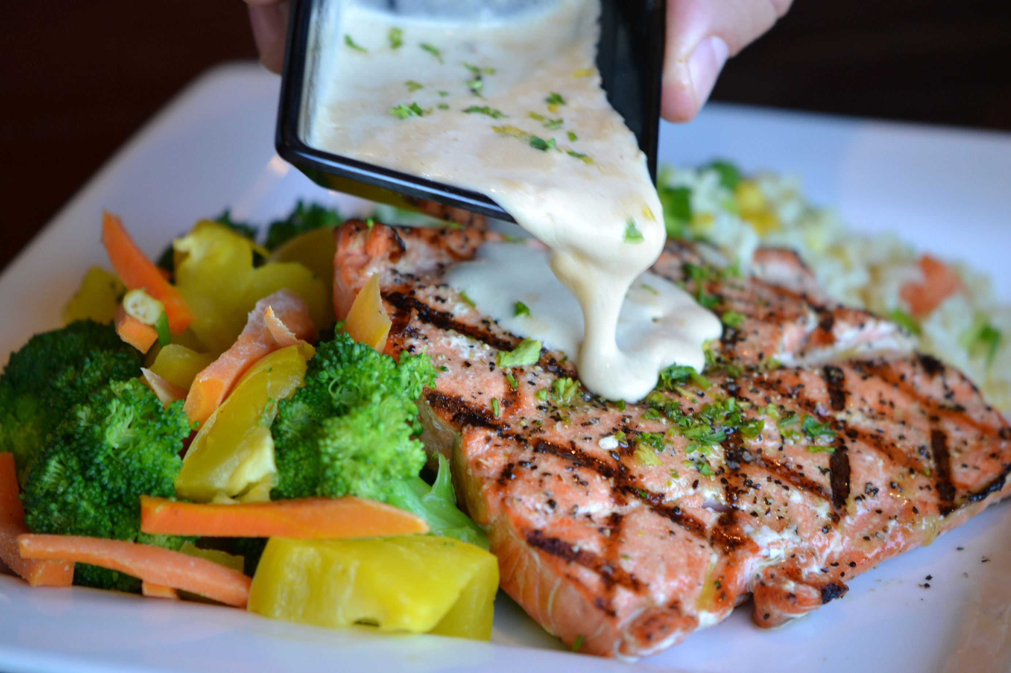

Unique Selling Point
Healthy has a new flavor — Delicious.
We’ve cracked the code: food that fuels your body and satisfies your cravings.
No more bland. No more boring. Just clean, crave-worthy goodness.

Slide 16

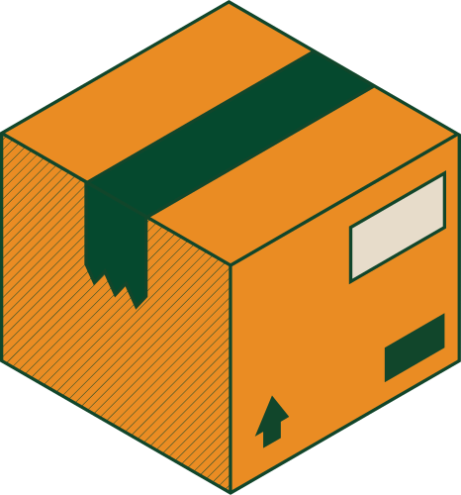


Marketing Mix
Price
product
Place
Promotion
• Our pricing will be affordable and competitive to ensure high quality at a reasonable cost.
• We will offer different meal plans to suit various needs and budgets.
• Special discounts and offers will be available for loyal customers and bulk orders.
Nutri Box offers healthy meals and nutrition tips.
• Our meals are great for people who want to stay fit, athletes, and anyone who needs balanced food.
• Our food is:
• Made with fresh ingredients.
• Free from preservatives.
• Calorie-counted for a healthy diet.
• Orders are available through social media (Facebook, Instagram, and WhatsApp).
• Delivery service is available in selected areas, with plans to expand based on demand.
Marketing on social media platforms through:
• Engaging content about healthy food and the importance of good nutrition.
• Paid ads to reach a larger audience.
• Special offers and discount coupons for new customers.

Slide 17
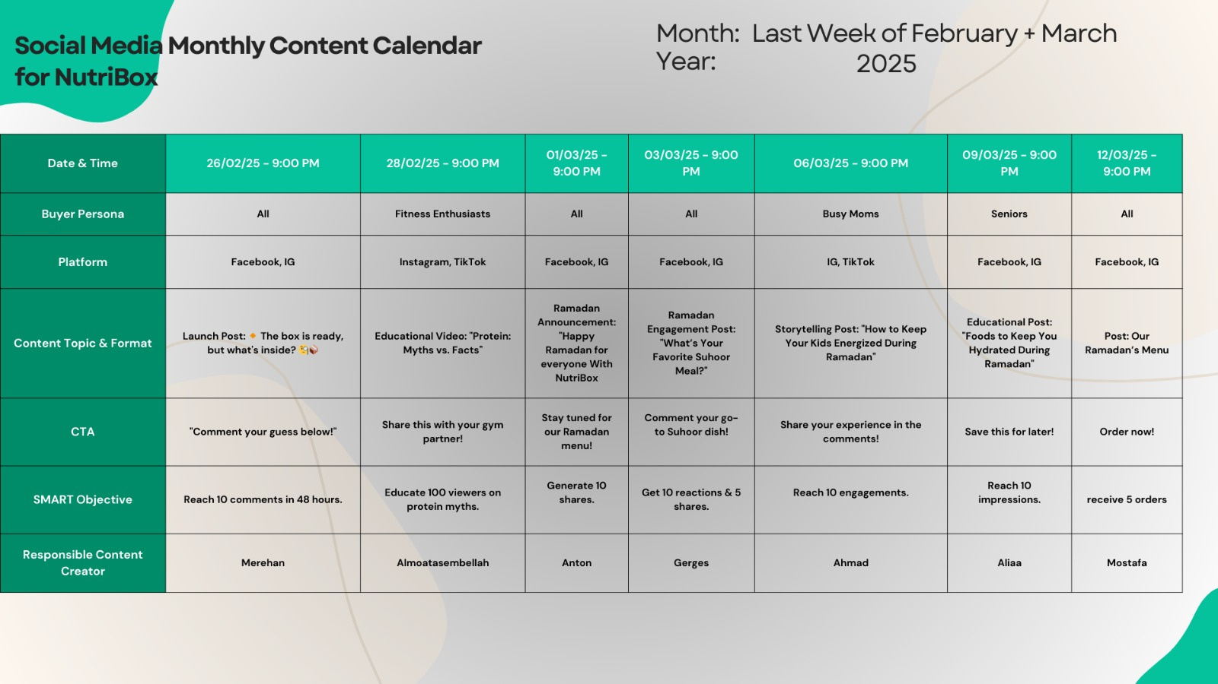
Content Calendar

Slide 18
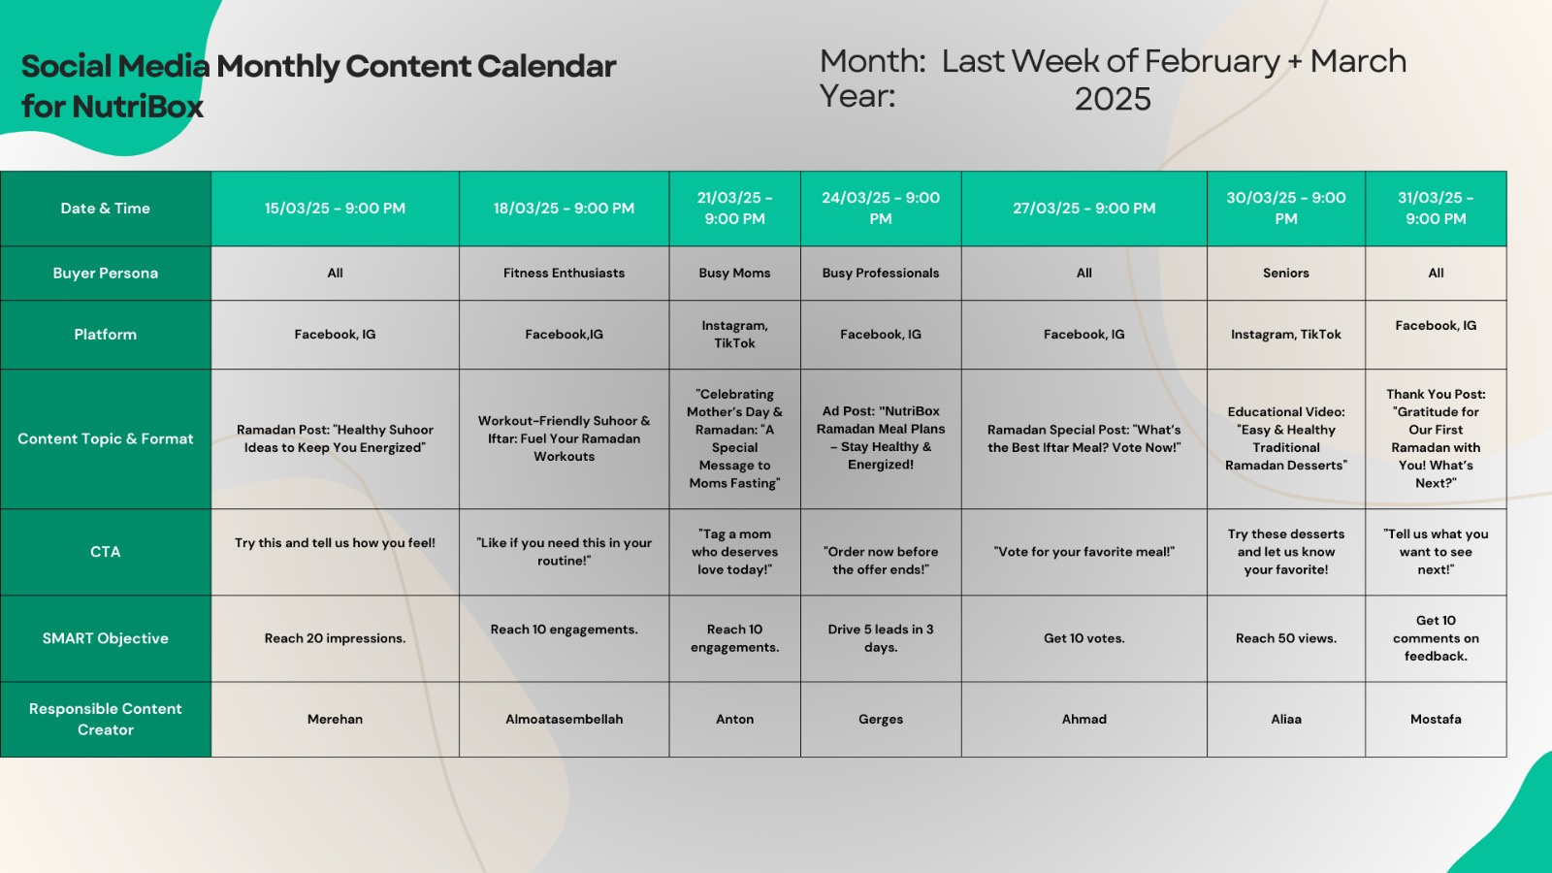
Content Calendar

Slide 19





Platforms Used
Facebook & Instagram: For ads, images, and promotional videos.
TikTok & Reels: To showcase recipes and health challenges in an engaging way.
WhatsApp: For taking orders and communicating with customers easily.
Type of Content
Photos and videos of dishes with ingredient details and calorie count.
Educational content about healthy eating habits and nutrition tips.
Product showcases to highlight different meal options and offers.
Seasonal & holiday celebrations with themed meals and special promotions.
Interactive content like quizzes, polls, and customer testimonials.

Slide 20
Time Table
Content Format
• A mix of educational, promotional, and interactive content to boost engagement and sales.
• Educational content twice a week about healthy eating and ingredient benefits.
• Promotional content twice a week to showcase meals and special offers.
• Special content for holidays and occasions with exclusive meals and discounts.
• Simple designs with colors that reflect health and nature (green – white – light orange).
• High-quality images and videos showcasing meal details.
• Consistent designs to maintain brand identity.
Tone Of Voice
Tone of Voice:
• Friendly, encouraging, and positive.
• Direct and easy-to-understand language without scientific complexity.
• Encouraging customer engagement, such as:
• “Who’s ready to try our new meal?”

Slide 21

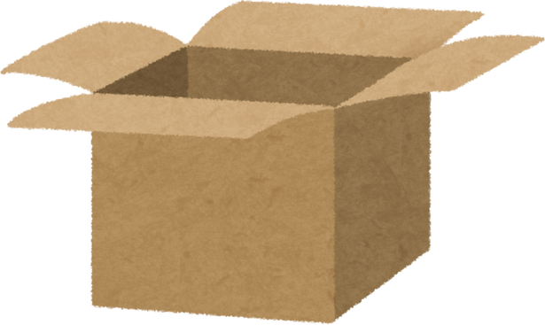




Headlines of POCs
1
4
Skip the powders… fuel your muscles with real food!
The mystery box is here! Can you guess what’s inside?
2
Finally, NutriBox is ready! Your healthy meals in one box!
5
Ramadan athletes! Ready for the best Suhoor & Iftar to power up your training?
3
We care about your health – enjoy delicious & nutritious meals!
6
On International Women’s Day, your health comes first!

Slide 22

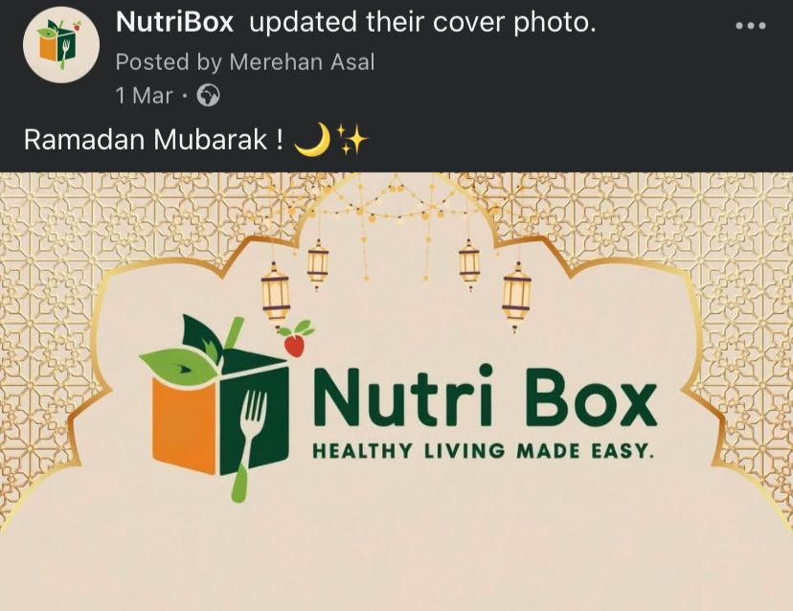
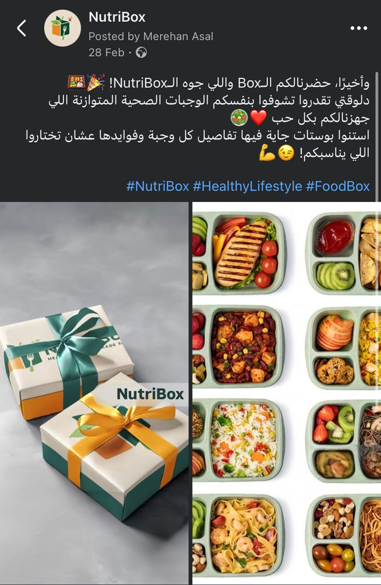

Slide 23
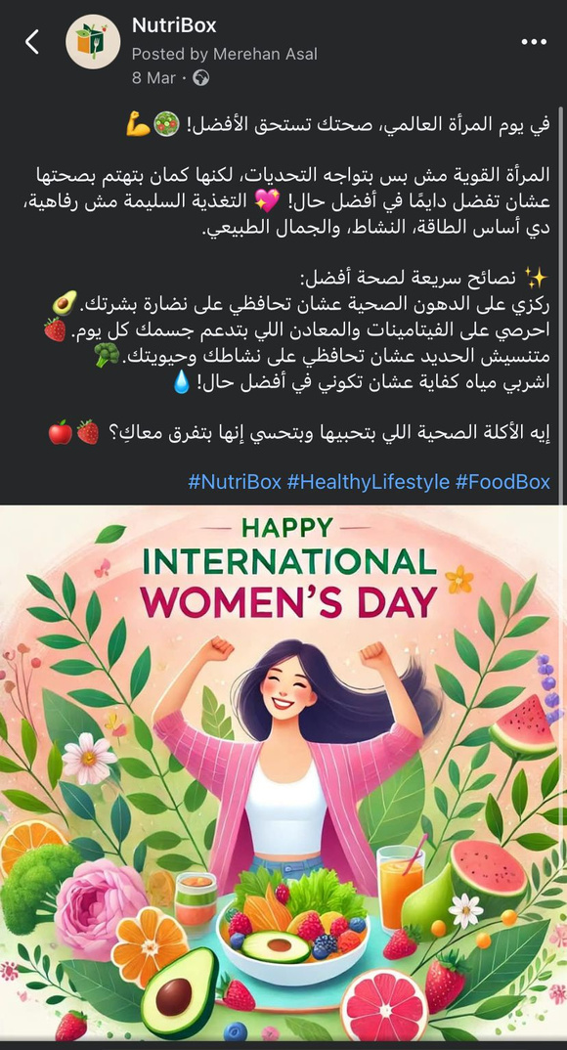
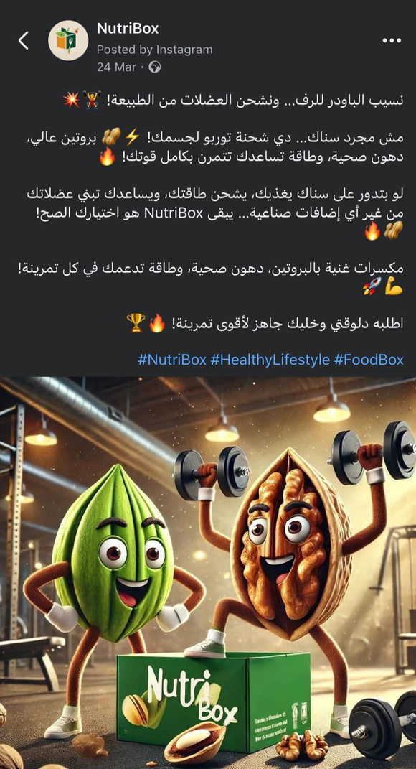

Slide 24
1
Digital Marketing Action Plan
Campaign Period: 1st March – 1st April
Objective: Launch and promote Nutri Box as a healthy food brand
using a lean digital strategy within a 1,000 EGP ad budget

Slide 25


🎯 Project Overview & Objective
Business Name: Nutri Box
Industry: Healthy Food / Meal Prep
Campaign Goal:
Create online presence across key digital platforms
Build initial awareness and engagement
Drive customer interest through visually compelling content
Run a small-scale paid campaign to test market responsiveness

Slide 26
💰 Budget Allocation (Total: 1,000 EGP)
Item | Allocation (EGP) | Notes
Facebook & Instagram Advertising | 1000 | Primary awareness & engagement ads
Budget Manager: Mr. Gerges
Date Finalized:April 1st

Slide 27
👥 Team Roles & Responsibilities
Name | Role | Responsibility | Due Dates
Mr. Anton | Situation Analysis | Conduct SWOT analysis, market trends, competitors | March 2–3
Mr. Motasem | Strategy | Define marketing objectives, positioning, tone of voice, key messaging | March 4–5
Miss Marehan | Tactics | Choose suitable digital channels, plan content categories, posting schedule | March 6–7
Ahmed Hossam | Execution | Set up social platforms, content design, publishing, video editing | March 8–31
Mr. Gerges | Control | Track performance, adjust ads, report analytics | March 15, 22, 29, April 1

Slide 28
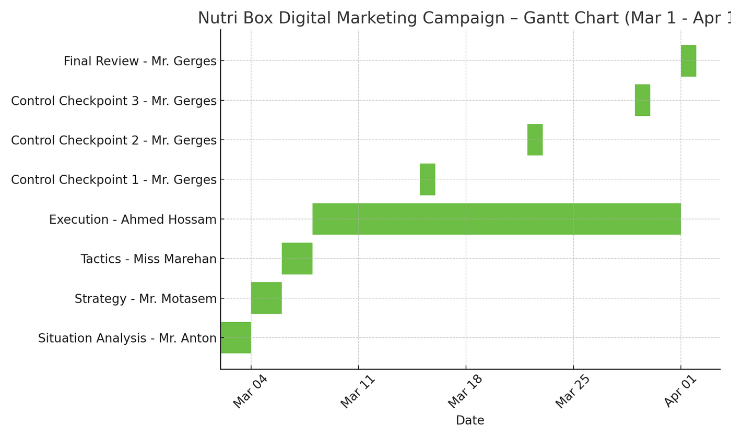
👥 Team Roles & Responsibilities

Slide 29
📱 Platform Setup & Optimization
Platforms to be Created & Optimized:
Facebook Page (Business category: Health Food / Food Delivery)
Instagram Business Account
TikTok Business Account
Google Business Profile (for local search visibility)
Optimization Checklist:
Professional profile and cover photos (logo, banner)
SEO-optimized bios with relevant keywords
Unified contact info and branding
Use of Linktree for centralized links
Branded hashtag: #NutriBoxEG

Slide 30
📆 Content Plan Execution
Responsible: Ahmed Hossam (Content), with guidance from Miss Marehan
Timeline: March 11–31
Content Objectives:
• Educate and entertain the audience on healthy eating
• Showcase meal quality, preparation process, and customer experiences
• Build trust and familiarity with the brand
Weekly Publishing Schedule:
Sunday Reel Behind the scenes: meal prep, kitchen activity
Monday Carousel Post Meal plan tips, transformations, testimonials
Wednesday Static Post Nutritional facts, ingredient spotlight
Friday Reel Customer review, unboxing, fun health challenge
Saturday Story Campaign Polls, questions, “this or that” food options
Tools Used:
• Canva (design)
• CapCut or InShot (video editing)
• ChatGPT (caption & hook writing)

Slide 31
📢 Ad Campaign Plan
Ad Launch Window: March 31– April 4
Targeting:
Age: 18–45
Location: [new cairo , zayed city , madnit nasr]
Interests: Fitness, health, meal planning, gym, diet
Language: Arabic (with casual Egyptian dialect)
Objectives:
Page Likes (Facebook)
Reel Engagement (Instagram + TikTok)
Story Views & Link Clicks (later stage)
A/B Testing:
Two ad variations: 1 emotional (health/lifestyle), 1 promotional (offer/meal photo)
Monitor CPM, CTR, and engagement levels weekly

Slide 32
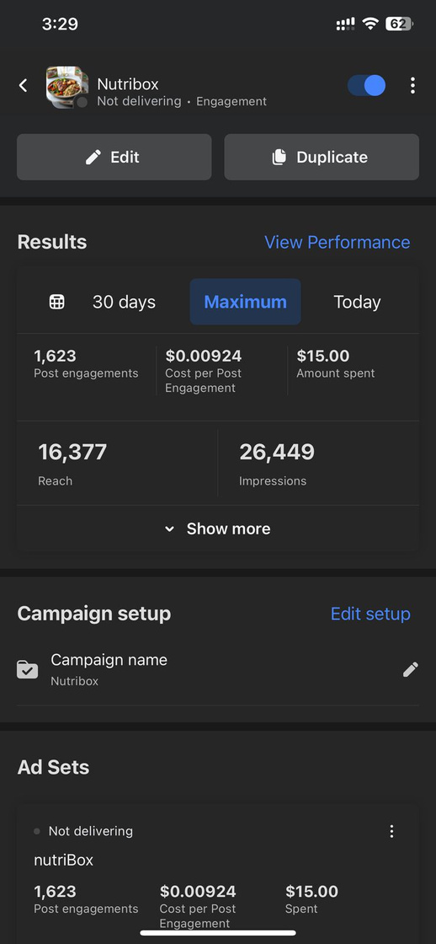
📊 Monitoring & Control
Control Dates:
March 15: Initial insights and ad performance
March 22: Mid-campaign adjustments
March 29: Final week boost strategy
April 1: Campaign report and team review
KPI Dashboard:
Reach & Impressions
Reach =16377 , reaction 1408
Engagement (likes, comments, shares)
Comments = 2 , share 5 ,clicks =2
Follower growth
Click-through rate (if links are used)
Cost per result (CPR) =0.01$

Slide 33

Set the suitable metrics to monitor your actions
FACEBOOK PAGE | NutriBox
Metric | Description
Reach | 16.5K
Engagement Rate | 1.7K
Followers | 155
 | 27.5K
views

Slide 34
Key Performance Indicators (KPIs)
KPI | Current (April) | Target (Next 3 Months) | Status
Followers (Facebook) | 153 | 300 | 🚧 Growing
Reach | 16,500 | +10% monthly | ✅ Good
Views (All content) | 27,500 | Double by June | 📈 In Progress
Engagements | 1700 | +30% | ⏳ Moderate

Slide 35


🔢 Section 2: Defined KPIs (Key Performance Indicators)
KPI
Time Frame
Goal Description
Increase in page followers
Monthly
Gain +14 followers in 30 days
Average engagement per post
Weekly
Achieve minimum 10 interactions per post
Leads generated via social
Campaign-based
Generate 50 form submissions from campaigns
Website traffic from Facebook
Monthly
27.4K

Slide 36














📈 Section 3: Social Media Reports
Content Breakdown:
"From our insights, we see that our content mix includes Reels, static images, and Stories. Here’s what the data tells us:"
Conclusion & Actionable Insights:
"So, what’s the takeaway?
Our reports confirm that while we’re getting great reach and viewer numbers, our next step is to convert these impressions into lasting engagement
Reels:
"Our video content, especially the reels, is really making waves. For instance, our 'Healthy Snack – Oats with Banana' Reel hit 9.5K views! That’s a clear signal: dynamic, short-form videos drive high engagement."
especially by ramping up our dynamic video content and filling in the gaps with more interactive Stories."
Static Images:
"Static posts, like our product showcases and educational graphics, are essential. However, they don't generate as much buzz as our reels. This tells us that while they maintain brand consistency, we could boost their performance by integrating more interactive elements."

Slide 37











Recommendations
01
02
03
04
05
06
Use CTAs effectively: Add "Follow us for more" on every post
Office/Remote Tour
Content Variety: Mix behind-the-scenes, testimonials, nutrition tips
Boost Stories: Daily stories with polls/questions
Try Paid Ads: Target nutrition and health audiences
Track Weekly: Analyze Insights and adjust accordingly
Focus on Reels: Post 3 reels per week

Slide 38
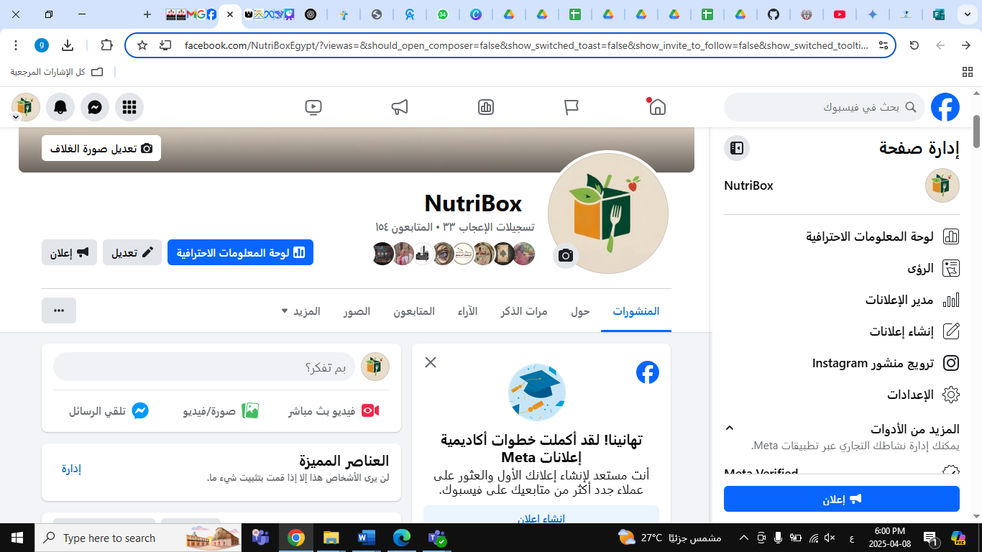

Slide 39
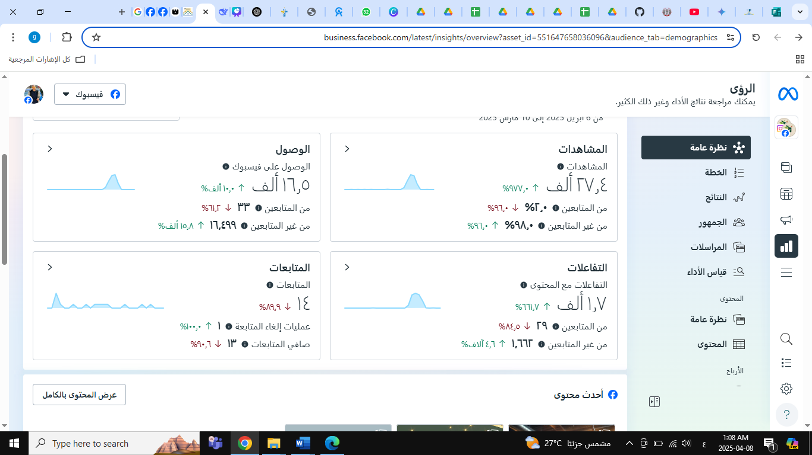

Slide 40
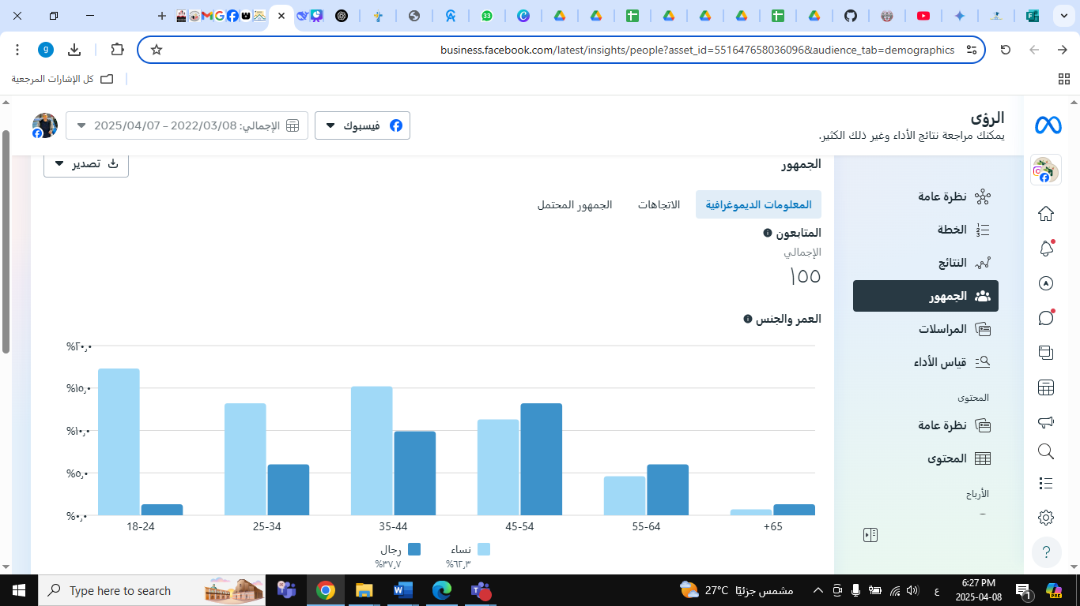

Slide 41
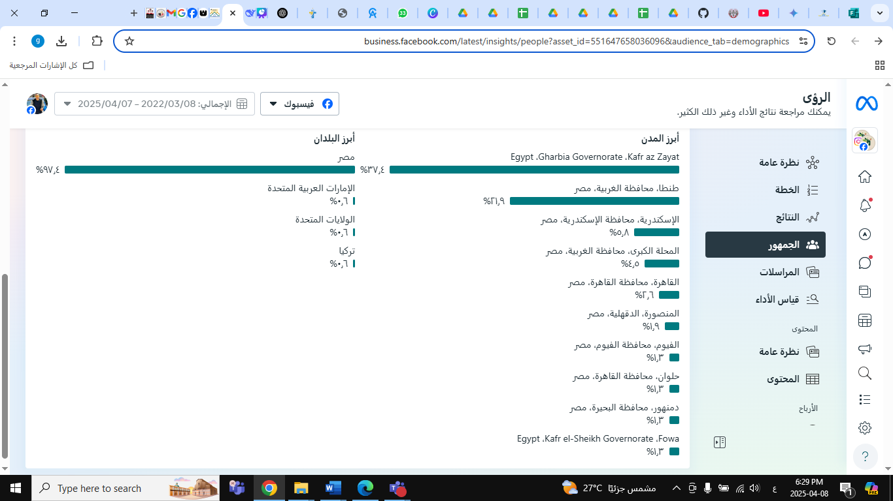

Slide 42

Contact Us
We want to hear from you
01117006563
OnLine

Slide 43
NutriBox
Thank You

